Slide 1
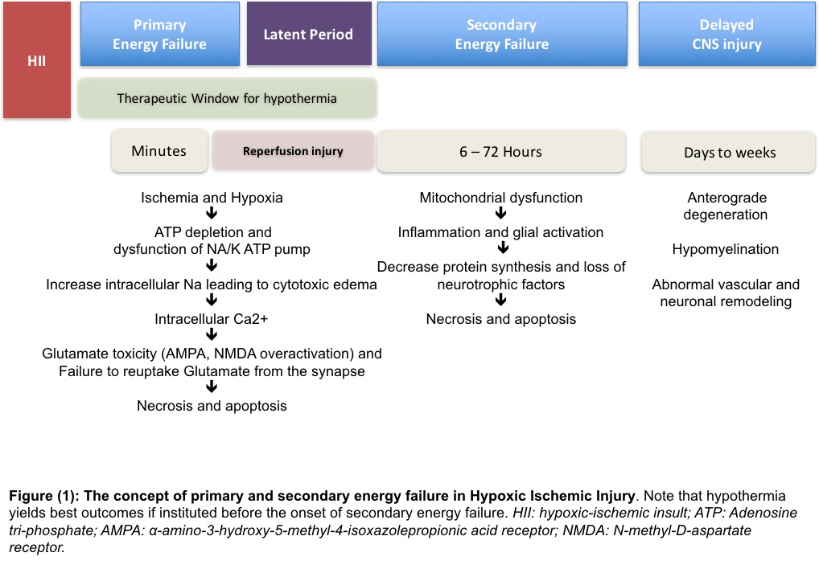

Slide 2
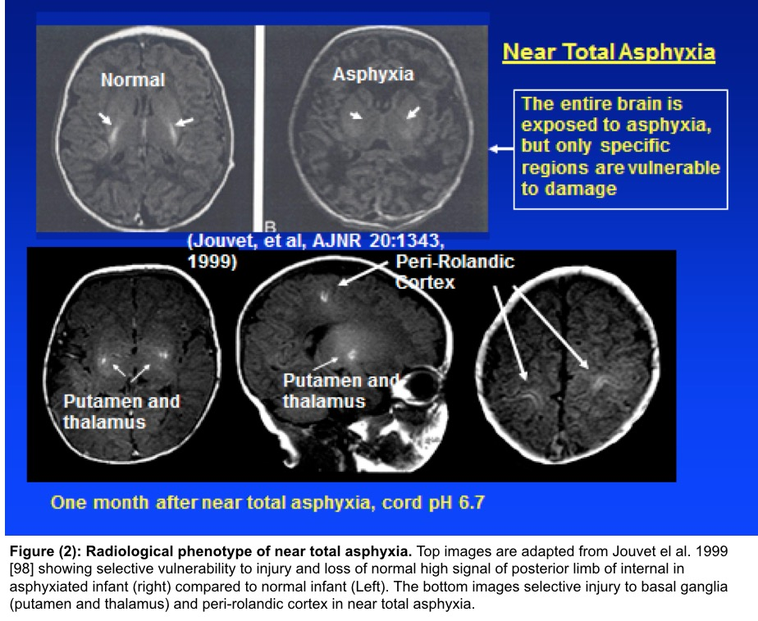

Slide 3
DWI pseudo-normalizes)
T1/T2 abnormal, progressive white matter damage
MRS lactate⬆
NAA ⬇
DWI abnormal (hyperintense)
T1/T2 Normal
MRS lactate⬆
NAA⬇
DWI abnormal (hyperintense)
T1/T2 abnormal
MRS: lactate ⬆
NAA ⬇
DWI (pseudo-normalizes)
T1/T2 abnormal
MRS lactate ⬆
NAA⬇
DWI abnormal
(hyperintense)
6 hrs
1-2 days
4-7 days
7-10 days
> 10 days
HII
Figure (3)

